Slide 1
Core Java
Manikanta R

Slide 2
Agenda
Decision making in Java
Operators in Java
File Handling in Java

Slide 3

Decision Making
Decision Making in programming is like decision-making in real life. In programming also face some situations where we want a certain block of code to be executed when some condition is fulfilled.
A programming language uses control statements to control the flow of execution of a program based on certain conditions. These are used to cause the flow of execution to advance, and branch based on changes to the state of a program.

Slide 4
Decision Making
if
if-else
if-else-if
switch-case
jump – break, continue, return

Slide 5
if
In Java , ‘if’ statement is used to control the flow of program based on conditional Expression.
if statement tests the condition. It executes the if block , if condition is true.
Syntax :
  If (condition) { // true
  // code to execute if the condition is true
  }

Slide 6
if
Example :
int number = 23;
If(number > 0){
System.out.println(“given Number is Positive”);
}

Slide 7
If-else
If -else statement is used for conditional branching, allowing you to execute different blocks of code based on whether a condition is true or false
The if statement alone tells us that if a condition is true it will execute a block of statements and if the condition is false it won’t. But what if we want to do something else if the condition is false? Here comes the else statement. We can use the else statement with the if statement to execute a block of code when the condition is false.

Slide 8
If-else
Syntax:
if(condition ) {
// code to be executed condition is true
} else {
// code to be executed condition is false
}

Slide 9
if-else
Example:
int age = 18;
  if(age >=18) {
  Candidate is Eligible to vote
  }else {
  Candidate is Not Eligible to vote
  }

Slide 10
if-else-ladder
Java if-else-if ladder is used to decide among multiple options. The if statements are executed from the top down. As soon as one of the conditions controlling the if is true, the statement associated with that if is executed, and the rest of the ladder is bypassed. If none of the conditions is true, then the final else statement will be executed.
If we have multiple conditions to evaluate, and if we must execute different code blocks based On which condition is true.

Slide 11
if-else-ladder
Syntax:
  Syntax :
  if (condition1) {
  // code to execute if cond1 is true
  } else if (condition2) {
  // code to execute if cond2 is true
  } else if (condition3) {
  // code to execute if cond3 is true
  } else if (condition4) {
  // code to execute if cond4 is true
  } else {
  // code to execute if none of the condition are true
  }

Slide 12
if-else-ladder
Example :
int num =7;
if (num < 0) {
  // no is -ve
  }else if {num ==0} {
  Given no is zero
  } else {
  // no is +ve
  }

Slide 13
switch
If we have several conditions to evaluate then recommended to use Switch statement.
The switch statement is used for making decisions based on the value of an expression.
It will allow you to specify a value and then execute different blocks of code based on Possible value of that expression.
Syntax:
  Switch (expression) {
    Case val1:
    //code to execute if expression is equals to val1
    break;
    Case val2:
    //code to execute if expression is equals to val2
    break;
    Case val3:
    //code to execute if expression is equals to val3
    break;
    default :
    //executed if none of expression is matched
  }

Slide 14
switch
Example:
  int dayOfWeek = 3;
  switch (dayOfWeek) {
    Case 1 :
    // Monday .
    break;
    Case 2 :
    //Tuesday;
    break;
    Case 3:
    //Wednesday
    break;
    Default :
    Some other day
  }

Slide 15
Loops In Java
For loop :
This is used for iterative control flow , allowing you to execute a block of code repeatedly for a specific number of times or based on a condition.
for loop provides a concise way of writing the loop structure. Unlike a while loop, a for statement consumes the initialization, condition and increment/decrement in one line thereby providing a shorter, easy to debug structure of looping.

Slide 16
For loop
Syntax :
  for (initialization; condition; increment/decrement) {
  // Code to be executed repeatedly
  }
Initialization condition: Here, we initialize the variable in use. It marks the start of a for loop. An already declared variable can be used or a variable can be declared, local to loop only.
Testing Condition: It is used for testing the exit condition for a loop. It must return a boolean value. It is also an Entry Control Loop as the condition is checked prior to the execution of the loop statements.
Statement execution: Once the condition is evaluated to true, the statements in the loop body are executed.
Increment/ Decrement: It is used for updating the variable for next iteration.
Loop termination: When the condition becomes false, the loop terminates marking the end of its life cycle.

Slide 17
for loop
  Example :
  for (int i=1; i<=5;i++) {
  // print i value
  }
int i = 1 initializes the loop control variable i to 1.
i <= 5 is the condition. As long as i is less than or equal to 5, the loop will continue.
i++ is the update. It increments i by 1 after each iteration.
So, this loop will print the numbers 1 through 5.
You can use for loops for a wide range of tasks, such as iterating over arrays, collections, or performing a fixed number of iterations, making it a powerful tool for repetition in Java programs.

Slide 18
While Loop
A while loop is a control flow statement that allows code to be executed repeatedly based on a given Boolean condition. The while loop can be thought of as a repeating if statement.
Syntax :
while (condition) {
//loop statements
}

Slide 19
while Loop
int i = 1;
while (i <= 5) {
System.out.println(i);
i++; // Increment the loop control variable.
}
In this example: int i = 1 initializes the loop control variable i to 1. i <= 5 is the condition. As long as i is less than or equal to 5, the loop will continue. i++ is used to increment i by 1 after each iteration. Without this line, the loop would run indefinitely. So, this while loop will print the numbers 1 through 5, similar to the for-loop example in the previous response. while loops are useful when you want to repeatedly execute a block of code until a specific condition becomes false. Just be careful to ensure that the condition will eventually become false; otherwise, you may create an infinite loop.

Slide 20
do-while Loop
In Java, a "do-while" loop is used to repeatedly execute a block of code while a specified condition is true.
The key difference between a "do-while" loop and a "while" loop is that a "do-while" loop will always execute its block of code at least once, even if the condition is initially false.
Syntax ;
do {
// statement
} while (condition) ;

Slide 21
do-while Loop
Example :
  int i = 1;
  do {
  System.out.println(i);
  i++;
  } while (i <= 5);
  This loop will print the numbers 1 to 5, and it will continue to execute if the condition i <= 5 is true. Once i becomes 6, the condition becomes false, and the loop exits.

Slide 22
for-each loop
For-each is another array traversing technique like for loop, while loop, do-while loop introduced in Java5.
It starts with the keyword for like a normal for-loop.
Instead of declaring and initializing a loop counter variable, you declare a variable that is the same type as the base type of the array, followed by a colon, which is then followed by the array name.
In the loop body, you can use the loop variable you created rather than using an indexed array element.
It’s commonly used to iterate over an array or a Collections classes (eg, ArrayList)
In Java, the "for-each" loop, also known as the enhanced for loop.

Slide 23
for-each loop
Syntax :
  for (datatype element : collection) {
  // Code to be executed for each element
  }
  datatype is the data type of elements in the collection.
  ArrayList<Employee> then datatype is Employee.
element is a temporary variable that represents each element in the collection.
collection is the array or collection you want to iterate through

Slide 24
for-each loop
Example :
int[] numbers = {1, 2, 3, 4, 5};
for (int num : numbers) {
System.out.println(num);
}
In this example, loop iterates through the numbers array, and num takes on the value of each element in the array in each iteration, which is then printed.
We can use the "for-each" loop with any collection that implements the Iterable interface, making it a convenient and concise way to loop through elements without worrying about indexing or length checks.

Slide 25
Continue
In Java, the continue statement is used within loops to skip the current iteration and move on to the next iteration of the loop.
It is often used to bypass certain parts of the loop's code based on a condition without exiting the loop entirely.
Continue is often used inside in programming languages inside loops control structures.
Inside the loop, when a continue statement is encountered the control directly jumps to the beginning of the loop for the next iteration instead of executing the statements of the current iteration.
The continue statement is used when we want to skip a particular condition and continue the rest execution. Java continue statement is used for all type of loops but it is generally used in for, while, and do-while loops.
Syntax :
Continue ;

Slide 26
Continue
Example:
for (int i = 1; i <= 10; i++) {
if (i % 2 == 0) {
// Skip even numbers
continue;
}
System.out.println(i);
}

Slide 27
break
break Statement is a loop control statement that is used to terminate the loop.
As soon as the break statement is encountered from within a loop, the loop iterations stop there, and control returns from the loop immediately to the first statement after the loop.
Syntax:
break;
  for (int i = 1; i <= 10; i++)
  if (i == 5) {
  // When i becomes 5, exit the loop
  break;
  }
  System.out.println(i);
  }
  In this example, the loop will print numbers from 1 to 4 and then exit when i becomes 5.

Slide 28
break
In a while or do-while loop:
int i = 1;
while (i <= 10) {
if (i == 5) {
// When i becomes 5, exit the loop
break;
}
System.out.println(i);
i++;
}
// refer switch example

Slide 29
return
The return statement is used within methods to specify the value that should be returned by the method when it is called. The return statement is used to exit a method and provide a result or value back to the caller.
Syntax:
return expression;

Slide 30
return
Example:
public boolean isPositive(int number) {
if (number > 0) {
return true;
// Return true if the number is positive
} else {
return false; // Return false otherwise
}
}
Remember that once a return statement is executed inside a method, it immediately exits the method, and no code after the return statement will be executed within that method.

Slide 31
Operators in JAVA
Operators constitute the basic building block to any programming language. Java too provides many types of operators which can be used according to the need to perform various calculations and functions, be it logical, arithmetic, relational, etc. They are classified based on the functionality they provide.
Here are a few types:
1. Arithmetic Operators
2. Unary Operators
3. Assignment Operator
4. Relational Operators
5. Logical Operators
6. Ternary Operator
7. Bitwise Operators

Slide 32
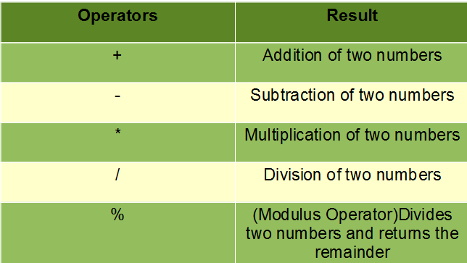
Arithmetic Operators:
These operators involve the mathematical operators that can be used to perform various simple or advanced arithmetic operations on the primitive data types referred to as the operands. These operators consist of various unary and binary operators that can be applied on a single or two operands. Let’s look at the various operators that Java has to provide under the arithmetic operators.

Slide 33
Unary Operators In Java
Java unary operators are the types that need only one operand to perform any operation like increment, decrement, negation, etc. It consists of various arithmetic, logical and other operators that operate on a single operand. Let’s look at the various unary operators in detail and see how they operate.
Unary Minus (-)
  This operator can be used to convert a positive value to a negative one.
  Syntax :
  - (operand)
  a = -10 ;
Not Operator (!)
    This is used to convert true to false or vice versa. Basically, it reverses the logical state of an operand.

Slide 34
Unary Operators In Java
Syntax :
! (operand)
Example :
Cond = ! true; -> false
3. Increment (++) :
It is used to increment the value of an integer. It can be used in two separate ways:
3.1: Post-increment operator
When placed after the variable name, the value of the operand is incremented but the previous value is retained temporarily until the execution of this statement, and it gets updated before the execution of the next statement.
Syntax :
i++;

Slide 35
Unary Operators In Java
Example :
  int i =5;
  j = i++ ; (//j = 5 in post increment first it will assign value and next i (6)val incremented)
3.2: Pre-increment operator
When placed before the variable name, the operand’s value is incremented instantly.
Syntax :
++ i ;
Example :
i = 5
j = ++ i (// j=6 first value will be incremented and assigned to j and i (6))

Slide 36
Unary Operators In Java
Operator 4: Decrement(–)
It is used to decrement the value of an integer. It can be used in two separate ways:
4.1: Post-decrement operator
When placed after the variable name, the value of the operand is decremented but the previous values is retained temporarily until the execution of this statement, and it gets updated before the execution of the next statement.
Syntax:
i--
Illustration:
i = 5
j = i-- (j=5 in post decrement first value will be assigned and then i will be decremented) .

Slide 37
Unary Operators In Java
4.2: Pre-decrement operator
When placed before the variable name, the operand’s value is decremented instantly.
Syntax:
-- i
Illustration:
i = 5
j = -- i // (j=4 in pre decrement first value will be updated and assigned i =4)

Slide 38
Assignment Operators In Java
Assignment Operator:
These operators are used to assign values to a variable. The left side operand of the assignment operator is a variable, and the right-side operand of the assignment operator is a value. The value on the right side must be of the same data type of the operand on the left side. Otherwise, the compiler will raise an error. This means that the assignment operators have right to left associativity, i.e., the value given on the right-hand side of the operator is assigned to the variable on the left. Therefore, the right-hand side value must be declared before using it or should be a constant. The general format of the assignment operator is,
variable operator value;
Types of Assignment Operators in Java
The Assignment Operator is generally of two types. They are:
1. Simple Assignment Operator: The Simple Assignment Operator is used with the “=” sign where the left side consists of the operand and the right side consists of a value. The value of the right side must be of the same data type that has been defined on the left side.
2. Compound Assignment Operator: The Compound Operator is used where +,-,*, and / is used along with the = operator.
Let’s look at each of the assignment operators and how they operate:

Slide 39
Assignment Operators In Java
(=) operator:
This is the most straightforward assignment operator, which is used to assign the value on the right to the variable on the left. This is the basic definition of an assignment operator and how it functions.
Syntax :
num1 = num2;
Example :
int a = 10;
char c = ‘y’;
1. (+=) operator :
This operator is a compound of ‘+’ and ‘=’ operators. It operates by adding the current value of the variable on the left to the value on the right and then assigning the result to the operand on the left.
a + 10 ; means a = a + 10;
(-=) , (*=), (/=) also same as above example

Slide 40
Relational Operators In Java
Java Relational Operators are a bunch of binary operators used to check for relations between two operands, including equality, greater than, less than, etc. They return a boolean result after the comparison and are extensively used in looping statements as well as conditional if-else statements and so on. The general format of representing relational operator is
Relational Operators
== , !=, > , < , >= , <=
Equal to (==) :
This operator is used to check whether the two given operands are equal or not. The operator returns true if the operand at the left-hand side is equal to the right-hand side, else false.
Not Equal to (!=)
This operator is used to check whether the two given operands are equal or not. It functions opposite to that of the equal-to-operator. It returns true if the operand at the left-hand side is not equal to the right-hand side, else false.

Slide 41
Relational Operators In Java
Greater Than (>):
This checks whether the first operand is greater than the second operand or not. The operator returns true when the operand at the left-hand side is greater than the right-hand side.
Less Than (<) :
This checks whether the first operand is less than the second operand or not. The operator returns true when the operand at the left-hand side is less than the right-hand side. It functions opposite to that of the greater-than operator.
Greater than or Equal to (>=) :
This checks whether the first operand is greater than or equal to the second operand or not. The operator returns true when the operand at the left-hand side is greater than or equal to the right-hand side.
Less than or Equal to (<=):
This checks whether the first operand is less than or equal to the second operand or not. The operator returns true when the operand at the left-hand side is less than or equal to the right-hand side.

Slide 42
Logical Operators In Java
Logical operators are used to perform logical “AND”, “OR” and “NOT” operations, i.e. the function similar to AND gate and OR gate in digital electronics. They are used to combine two or more conditions/constraints or to complement the evaluation of the original condition under particular consideration. One thing to keep in mind is, while using AND operator, the second condition is not evaluated if the first one is false. Whereas while using OR operator, the second condition is not evaluated if the first one is true, i.e. the AND and OR operators have a short-circuiting effect. Used extensively to test for several conditions for making a decision.
AND Operator ( && ) – if( a && b ) [if true execute else don’t]
OR Operator ( || ) – if( a || b) [if one of them is true to execute else don’t]
NOT Operator ( ! ) – !(a<b) [returns false if a is smaller than b]
1. Logical ‘AND’ Operator (&&)
This operator returns true when both the conditions under consideration are satisfied or are true. If even one of the two yields false, the operator results false. In Simple terms, cond1 && cond2 returns true when both cond1 and cond2 are true (i.e. non-zero).

Slide 43
Logical Operators In Java
Syntax:
condition1 && condition2
2. Logical ‘OR’ Operator (||)
This operator returns true when one of the two conditions under consideration is satisfied or is true. If even one of the two yields true, the operator results true. To make the result false, both the constraints need to return false.
Syntax:
condition1 || condition2
3. Logical ‘NOT’ Operator (!)
Unlike the previous two, this is a unary operator and returns true when the condition under consideration is not satisfied or is a false condition. Basically, if the condition is false, the operation returns true and when the condition is true, the operation returns false.
Syntax:
!(condition)

Slide 44
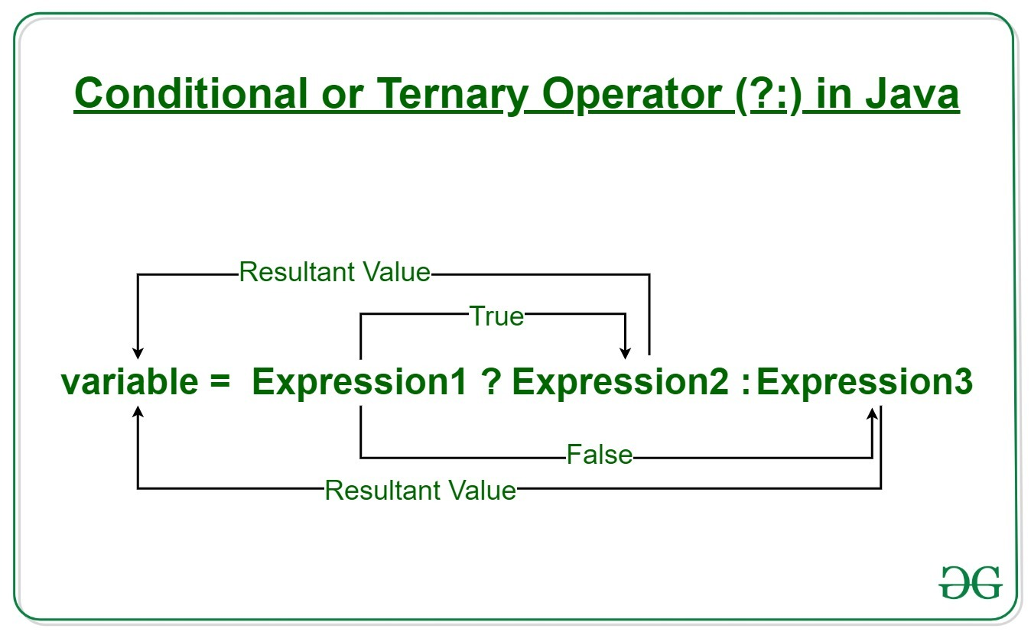
Ternary Operators In Java
Java ternary operator is the only conditional operator that takes three operands. It’s a one-liner replacement for the if-then-else statement and is used a lot in Java programming. We can use the ternary operator in place of if-else conditions or even switch conditions using nested ternary operators. Although it follows the same algorithm as of if-else statement, the conditional operator takes less space and helps to write the if-else statements in the shortest way possible.
Syntax:
variable = Expression1 ? Expression2 : Expression3

Slide 45
Bitwise Operators In Java
Bitwise operators are used to performing the manipulation of individual bits of a number. They can be used with any integral type (char, short, int, etc.).
1. Bitwise OR (|)
This operator is a binary operator, denoted by ‘|’. It returns bit by bit OR of input values, i.e., if either of the bits is 1, it gives 1, else it shows 0.
Example:
  a = 5 = 0101 (In Binary)
  b = 7 = 0111 (In Binary)
  Bitwise OR Operation of 5 and 7
  0101
  | 0111
  ________
  0111 = 7 (In decimal)

Slide 46
Bitwise Operators In Java
Bitwise operators are used to performing the manipulation of individual bits of a number. They can be used with any integral type (char, short, int, etc.).
1. Bitwise OR (|)
This operator is a binary operator, denoted by ‘|’. It returns bit by bit OR of input values, i.e., if either of the bits is 1, it gives 1, else it shows 0.
Example:
  a = 5 = 0101 (In Binary)
  b = 7 = 0111 (In Binary)
  Bitwise OR Operation of 5 and 7
  0101
  | 0111
  ________
  0111 = 7 (In decimal)

Slide 47
Bitwise Operators In Java
2. Bitwise AND (&)
This operator is a binary operator, denoted by ‘&.’ It returns bit by bit AND of input values, i.e., if both bits are 1, it gives 1, else it shows 0.
Example:
  a = 5 = 0101 (In Binary)
  b = 7 = 0111 (In Binary)
Bitwise AND Operation of 5 and 7
  0101
  & 0111
  ________
  0101 = 5 (In decimal)

Slide 48
Bitwise Operators In Java
4. Bitwise Complement (~)
This operator is a unary operator, denoted by ‘~.’ It returns the one’s complement representation of the input value, i.e., with all bits inverted, which means it makes every 0 to 1, and every 1 to 0.
Example:
a = 5 = 0101 (In Binary)
Bitwise Complement Operation of 5
~ 0101
________
1010 = 10 (In decimal)
Note: Compiler will give 2’s complement of that number, i.e., 2’s complement of 10 will be -6.

Slide 49
File Handling
In Java, with the help of File Class, we can work with files. This File Class is inside the java.io package. The File class can be used by creating an object of the class and then specifying the name of the file.
https://docs.oracle.com/javase/8/docs/api/java/io/File.html
Syntax :
File file = new File(path);
Why File Handling is Required?
• File Handling is an integral part of any programming language as file handling enables us to store the output of any particular program in a file and allows us to perform certain operations on it.
• In simple words, file handling means reading and writing data to a file.
Streams in Java
• In Java, a sequence of data is known as a stream.
• This concept is used to perform I/O operations on a file.
• There are two types of streams :
1. Input Stream.
2. Output Stream.

Slide 50
File Handling
1. Input Stream:
The Java InputStream class is the superclass of all input streams. The input stream is used to read data from numerous input devices like the keyboard, network, etc. InputStream is an abstract class, and because of this, it is not useful by itself.
However, its subclasses are used to read data.
FileInputStream
ByteArrayInputStream
ObjectInputStream
Create InputStream:
Inputstream inputstream = new FileInputStream();
We can create an input stream from other subclasses as well as InputStream.

Slide 51
FileInput Stream
Java FileInputStream class obtains input bytes from a file. It is used for reading byte-oriented data (streams of raw bytes) such as image data, audio, video etc. You can also read character-stream data. But, for reading streams of characters, it is recommended to use File Reader class.
Java FileInputStream class declaration
public class FileInputStream extends InputStream
Example :
InputStream inputStream = new FileInputStream("C:\\gx\\file.txt");
int i = 0;
while ((i = inputStream.read())!=-1) {
System.out.print((char)i);
}
inputStream.close();
}

Slide 52
ByteInput Stream
The ByteArrayInputStream is composed of two words: ByteArray and InputStream. As the name suggests, it can be used to read byte array as input stream.
Java ByteArrayInputStream class contains an internal buffer which is used to read byte array as stream. In this stream, the data is read from a byte array. The buffer of ByteArrayInputStream automatically grows according to data.
Java ByteArrayInputStream class declaration
public class ObjectInputStream extends InputStream implements ObjectInput, ObjectStreamConstants
String val1 = "Hello World ";
@SuppressWarnings("resource")
ObjectOutputStream outputStream = new ObjectOutputStream(new FileOutputStream("C:\\gx\\file1.txt"));
outputStream.writeObject(val1);
outputStream.writeObject(new byte[] {95,96,98,99});
ObjectInputStream objectInputStream = new ObjectInputStream(new FileInputStream("C:\\gx\\file1.txt"));
String read1 = (String)objectInputStream.readObject();
System.out.println(read1);
byte[] read = (byte[])objectInputStream.readObject();
for (byte val : read) {
System.out.println(val);
}

Slide 53
File Handling
2. Output Stream:
The output stream is used to write data to numerous output devices like the monitor, file, etc. OutputStream is an abstract superclass that represents an output stream. OutputStream is an abstract class and because of this, it is not useful by itself.
However, its subclasses are used to write data.
FileOutputStream
ByteArrayOutputStream
ObjectOutputStream
Creating Output Stream :
OutputStream outputStream = new FileOutputStream();
We can create an output stream from other subclasses as well as outputStream.

Slide 54
File OutputStream
Java FileOutputStream is an output stream used for writing data to a file.
If you have to write primitive values into a file, use FileOutputStream class. You can write byte-oriented as well as character-oriented data through FileOutputStream class. But, for character-oriented data, it is preferred to use FileWriter than FileOutputStream.
public class FileOutputStream extends OutputStream
Example :
String s = "Hello world!!!";
FileOutputStream fileOutputStream = new FileOutputStream(new File("C:\\gx\\fos.txt"));
fileOutputStream.write(s.getBytes());
fileOutputStream.close();

Slide 55
ByteArray OutputStream
Java ByteArrayOutputStream class is used to write common data into multiple files. In this stream, the data is written into a byte array which can be written to multiple streams later.
The ByteArrayOutputStream holds a copy of data and forwards it to multiple streams.
The buffer of ByteArrayOutputStream automatically grows according to data.
public class ByteArrayOutputStream extends OutputStream
Ex:
FileOutputStream fileOutputStream = new FileOutputStream(new File("C:\\gx\\fos.txt"));
FileOutputStream fileOutputStream1 = new FileOutputStream(new File("C:\\gx\\fos1.txt"));
ByteArrayOutputStream byteArrayOutputStream = new ByteArrayOutputStream();
byteArrayOutputStream.write(65);
byteArrayOutputStream.writeTo(fileOutputStream);
byteArrayOutputStream.writeTo(fileOutputStream1);

Slide 56
Serialization and Deserialization
Serialization is a mechanism of converting the state of an object into a byte stream. Deserialization is the reverse process where the byte stream is used to recreate the actual Java object in memory. This mechanism is used to persist the object.
The byte stream created is platform independent. So, the object serialized on one platform can be deserialized on a different platform. To make a Java object serializable we implement the java.io.Serializable interface. The ObjectOutputStream class contains writeObject() method for serializing an Object.
public final void writeObject(Object obj)
throws IOException
The ObjectInputStream class contains readObject() method for deserializing an object.
public final Object readObject()
throws IOException,
ClassNotFoundException

Slide 57
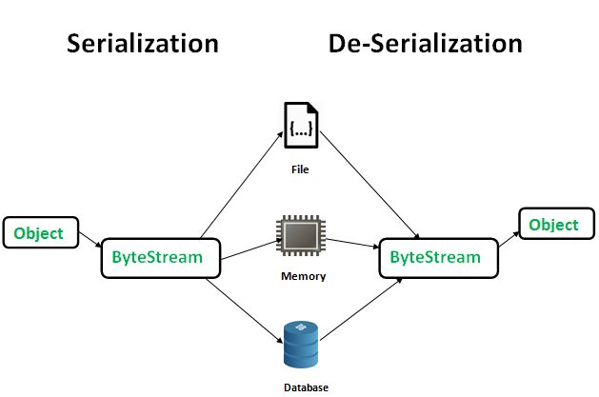
Serialization and Deserialization
Advantages of Serialization
1. To save/persist state of an object.
2. To travel an object across a network.

Slide 58
Serialization and Deserialization
Patient patient = new Patient();
patient.setId(123);
patient.setName("abc");
FileOutputStream fileOutputStream = new FileOutputStream(new File("C:\\gx\\fos.txt"));
ObjectOutputStream objectOutputStream = new ObjectOutputStream(fileOutputStream);
objectOutputStream.writeObject(patient);
objectOutputStream.close();
FileInputStream fis = new FileInputStream(new File("C:\\gx\\fos.txt"));
ObjectInputStream objectInputStream = new ObjectInputStream(fis);
Patient oisPatient = (Patient) objectInputStream.readObject();
System.out.println(oisPatient.getId() + "---" + oisPatient.getName());

Slide 59




Thank you

